Slide 1
Nail Setup for Remote Therapy Using the Oberon
Michelle L. Pierluissi

Slide 2
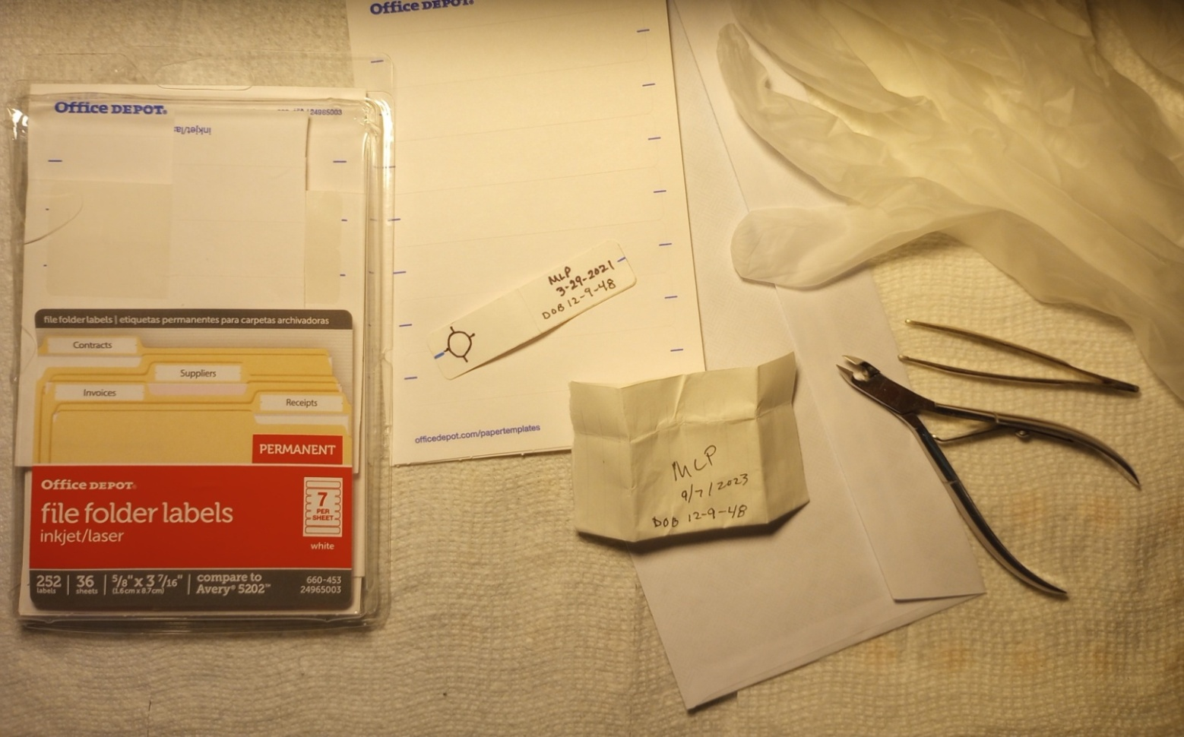
PREPARING THE NAIL CLIPPINGS
Items:
Labels or an envelope you can cut up into smaller versions
Cuticle cutter to trim some of the sharp ends of nail clippings if you are using the labels so that they don’t protrude from the paper carrier.
Tweezers
Gloves
Alcohol to clean the tools before and after handling each person’s nails.

Slide 3
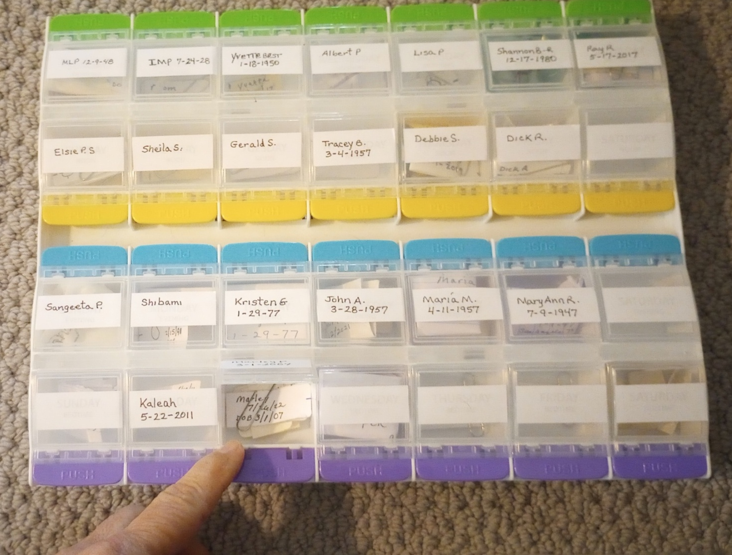
Storing Everyone’s Nails
I found this pill carrier at a pharmacy and adapted it for my nail storage system.

Slide 4
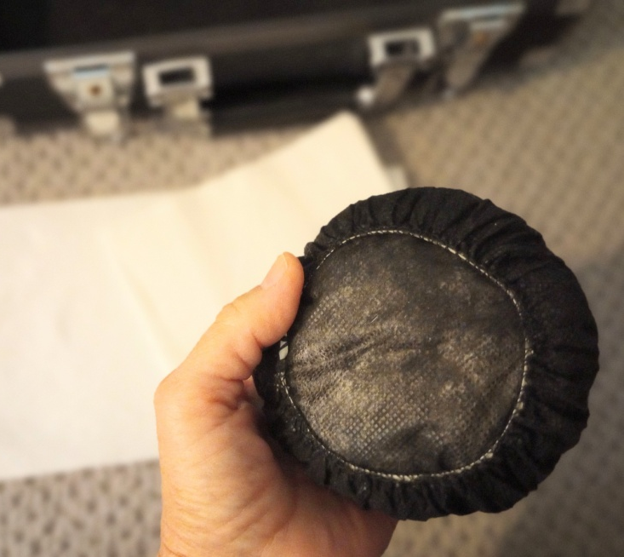
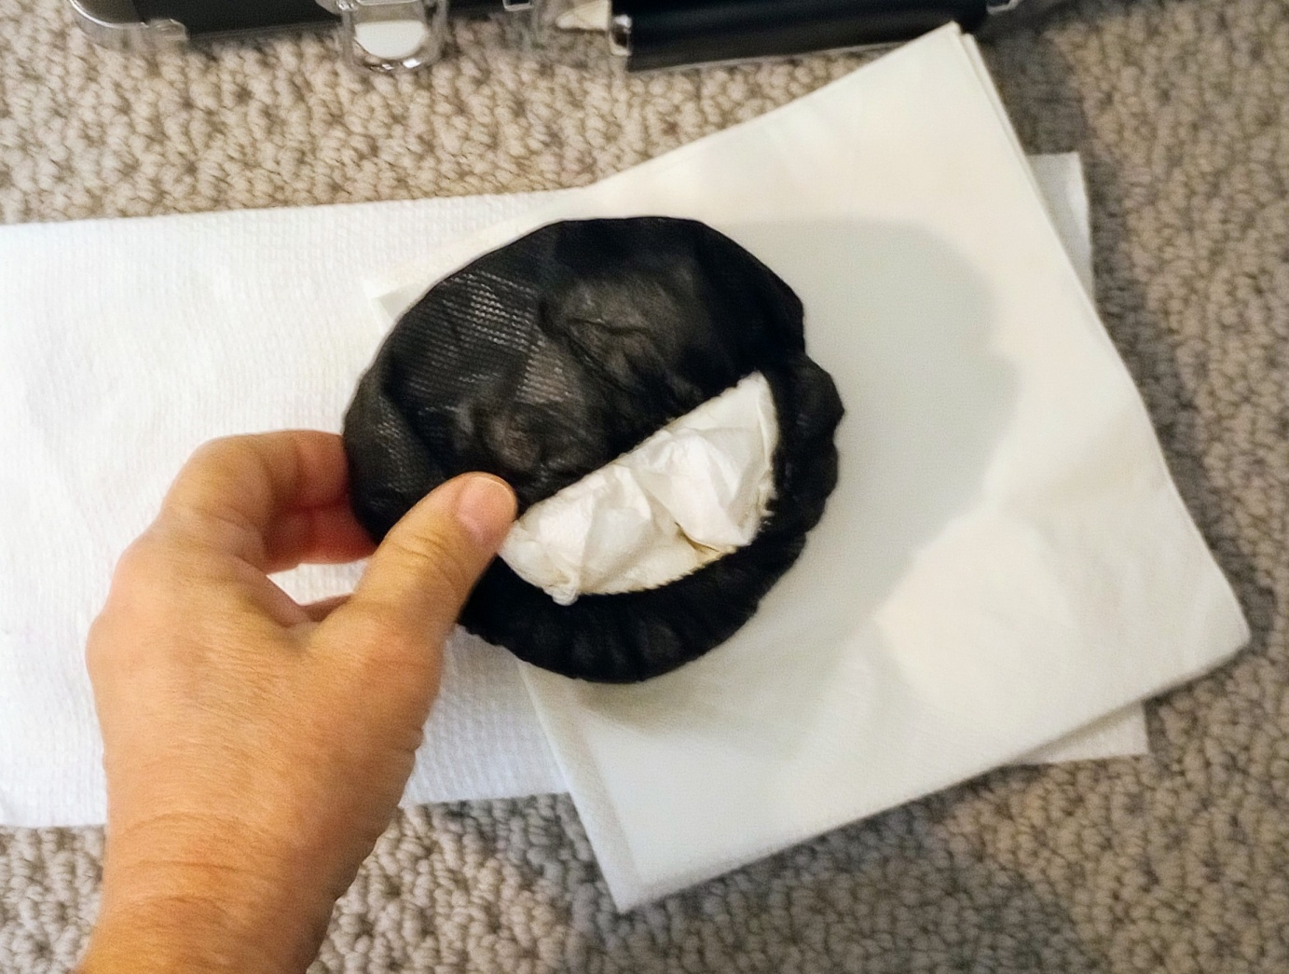
Prepare the support for the Nails using one set of headset covers and stuff them with about seven white paper napkins that you crumble up.

Slide 5
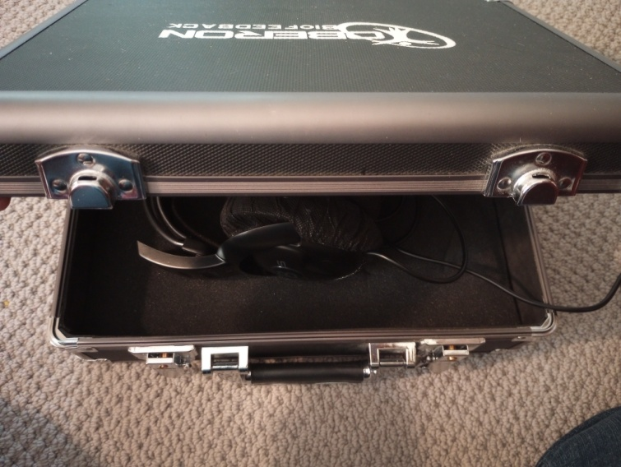
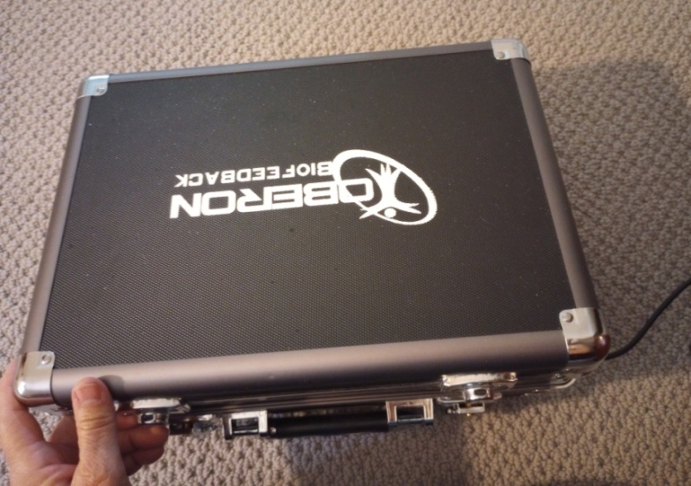
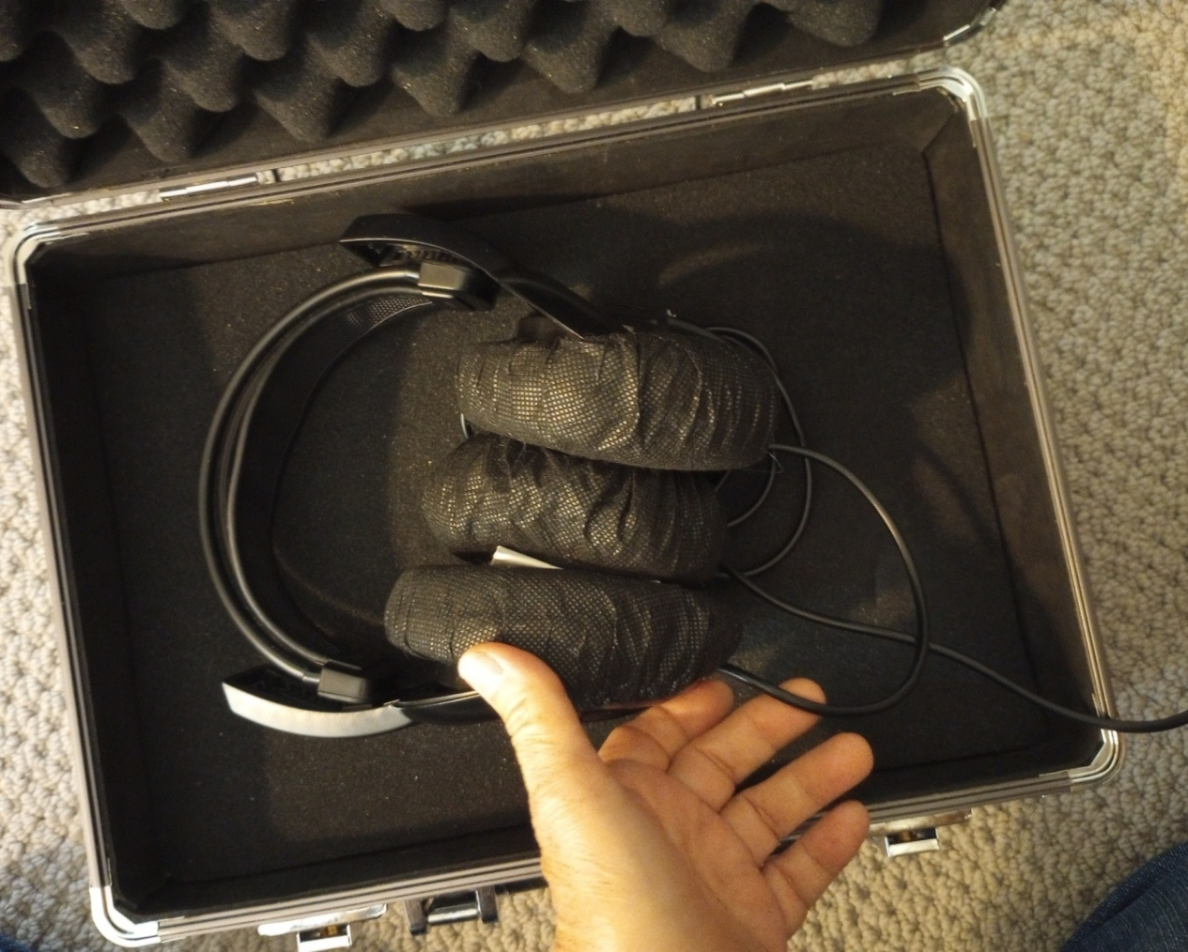
Place the napkin support between the headset and place the envelope or label carrier up against the left set containing the wire. Close the case gently with the electrical cord coming out the front corner of the case. The headset will keep the case slightly open.
Now you can begin your scanning.

